Slide 1
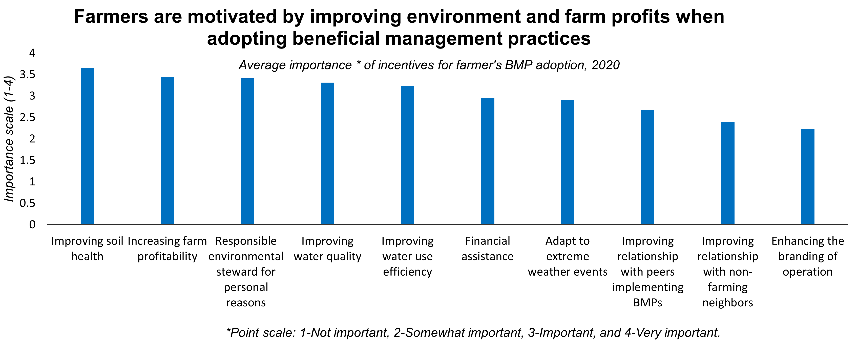
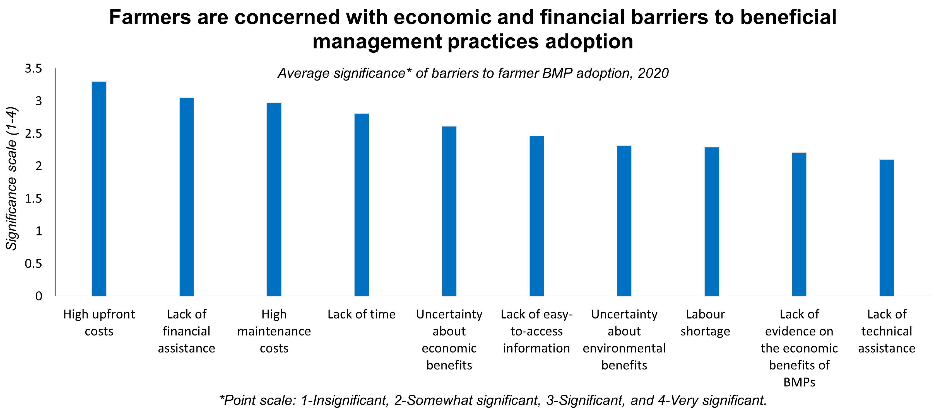
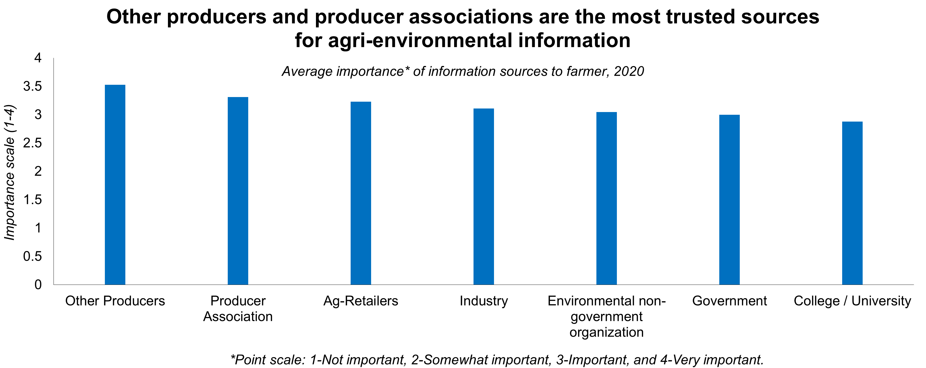
Barriers and incentives for farmers to adopt beneficial management practices in Manitoba by Bijal Patel¹, Jun Zhao², Marina Puzyreva³, and Geoffrey Gunn³
1. Graduate student, Department of Applied Economics and Finance, HEC Montreal (University of Montreal), and Agriculture and Agri-Food Canada; 2. Agriculture and Agri-Food Canada;
3. International Institute for Sustainable Development
Background
Results
Conclusion
The Living Labs Initiative of Agriculture and Agri-Food Canada (AAFC) is a new approach to agricultural innovation in Canada that brings together farmers, scientists, and other collaborators to co-develop and test beneficial management practices (BMPs) to address agri-environmental issues. In order to improve BMP adoption, it is important to first understand the barriers and incentives for farmers to adopt BMPs.
Our analytical results show that:
The top incentives to BMP adoption were improving soil health, increasing farm profitability and being a responsible environmental steward.
The top barriers to BMP adoption were high upfront costs, lack of financial assistance and high maintenance costs.
Along with other producers and producer associations, government was also a trusted source of information.
Many farmers prefer to receive information about BMPs by attending tours and field trips, group discussions, and by accessing print publications.
Producers' participation in Living Labs had positive impacts on their future BMP adoption and their social networks, such as their relationships with other producers and with representatives from governments and organizations.
Objectives
The objective of this research, which is a part of the socio-economic research component for the Living Lab – Eastern Prairies (LLEP) project, is to identify:
the barriers and incentives for farmers to adopt BMPs in southern Manitoba
farmers’ trusted sources for agri-environmental information
the impacts of Living Lab participation
Method and data source
Policy implications
Data used in this poster comes from a survey collaboratively developed by International Institute for Sustainable Development (IISD) and AAFC in 2020 as part of the LLEP project.
70 producers responded to the survey.
4-point scale approach was applied to analyze importance or significance of barriers and incentives for farmers to adopt BMPs. Statistical analysis methods (e.g., Wilcoxon test) were used in examining significance of differences in barriers and incentives among different producer groups.
The results will provide policy makers and program officials with a better understanding of the practical farm level considerations that influence farmers’ BMP adoption, and inform BMP-related policies and programs.
Survey results can be used to inform policy makers about potential variations in barriers and incentives among different groups of producers, thereby allowing for tailoring of messaging.
Enabling peer-to-peer communication encourages BMP adoption, and providing on-farm tours to interested farmers where the early adopters can share their experiences appears to be a good strategy to increase awareness about BMPs.
For more information about the research, please contact Bijal Patel (bijal.patel@hec.ca).

